Slide 1


Slide 2


Southeast Asia Business Event Forum 2023
The MICE Industry in Asia, ASEAN & Indonesia
Presented by:
Edward Liu
Managing Director, Conference & Exhibition Management Services Honorary President, AFECA
Honorary President, SACEOS

Slide 3


Content
01 | The Exhibition Man
02 | Two Decades of Asianisation of MICE Industry
03 | Towards Aseanisation of the MICE Industry
04 | Indonesia to the Fore
05 | Conclusion

Slide 4
The Exhibition Man
1979
 |  |  | Organised Computa, the first computer exhibition in Singapore
1981 |  |  | Launched the premiere Asian Aerospace in Singapore
1993 |  |  | Organised the only Thai Airshow in Kamphaeng Saen, Thailand
1987
Launched the Defence Asia series in Bangkok, Thailand

Slide 5
The Exhibition Man
1981 |  |  | Elected as the first president of SACEOS, Singapore
2001
2005 |  |  | Appointed Advisor to CCPIT HQ, China (Exhibition Industry)
2007 |  |  | Assumed Presidency of AFECA, Asia
2018 |  |  | Inducted into Hall of Leaders, Convention Industry Council, USA
Elected to the Board of Directors of IAEE, USA

Slide 6

When China joined the World Trade Organisation (WTO) in 2001, it boosted trade
Two decades of Asianisation of the MICE Industry
and industries throughout Asia
Many European and US organisers converged in Asia in the last 20 years, igniting the Asianisation of the MICE industry

Slide 7
This also sparked the emergence of more
local organisers throughout Southeast Asia, and in East Asia, particularly in China
Two Decades of Asianisation of the MICE Industry
The effect of this Asianisation of the MICE industry was the proliferation of exhibitions across Asia, uplifting the economic growth and development in the region
Indeed, the Exhibition Industry is a function of the economy.

Slide 8
Impact of Covid-19 Pandemic
With the onset of Covid-19 pandemic in early 2020, the entire MICE industry in Asia was disrupted
Most organisers were forced to cancel or postpone their events and some had shut their entire operations. Staff were displaced
Some of the senior management staff were relocated to Southeast Asian countries which boast of a market size of more than 684 million people
With the closure of the China market in the last three years, many European and US organisers had decided to deploy their resources out of China

Slide 9
Post Covid-19 Pandemic
With the sudden reopening of borders by China earlier this year, most foreign organisers are now monitoring the situation closely and reassessing their options in mainland China
Most of them had incurred heavy losses during the Covid-19 pandemic period as many cities from Beijing to Shanghai were locked down for long periods
Another major consideration is the current geopolitical tensions between China and the US and its European allies
Many of the European and US organisers are now at a crossroad, to stay put in mainland China and or to move to the Southeast Asia countries

Slide 10

Impacted by Covid-19 pandemic and the closure of the China market amidst tension amongst the superpowers, many foreign organisers were eyeing the ASEAN market in the past years
Towards Aseanisation of the MICE Industry
Some of the European organisers have begun acquiring local companies or their events in order to fast track their entry into the
Southeast Asian region

Slide 11
Indeed, the Aseanisation of the MICE industry has commenced and we can expect more conferences and exhibitions to be staged in the
Towards Aseanisation of the MICE Industry
ASEAN region in this decade
Meantime, the recovery rate is likely to be between 60 and 80 per cent in different countries for this year, with full recovery to be achieved by next year at the earliest

Slide 12
Current Situation in ASEAN
With the reopening of the China borders and market since January, it would be a boost to the MICE industry and the entire economies in the Southeast Asian region
Singapore is making strong headways in the recovery in the MICE market and it has attracted new European players into the country.
Recovery is about 80 per cent for this year

Slide 13
Current Situation in ASEAN
Malaysia is moving ahead in the MICE industry but at a slightly slower pace. Full recovery is expected by next year
Thailand is pushing ahead with more consumer rather than business events while the Philippines and Vietnam are also making headways, albeit at a distance

Slide 14
Indonesia to the Fore
With some 273.8 million population, Indonesia is likely to be at the centre of the Aseanisation of the MICE industry in this decade
The MICE industry would boom if Indonesia could further develop its strategic
locations (air connectivity and accessibility), resources and markets and government regulations optimally
Most foreign organisers are now studying the huge Indonesia market and are making plans to launch new events in the country, before too long
Concurrently, European organisers are likely to launch M&A activities in Indonesia in order to expedite their entry into this huge market

Slide 15
Indonesia leads the way
With the seat of ASEAN Headquarters in Jakarta, Indonesia could do more for the MICE
industry by launching an ASEAN Expo focusing on key industries and innovations for the Southeast Asian region
This ASEAN Expo could be rotated amongst the Southeast Asian countries with possible funding support from the ASEAN Headquarters and participating countries
Indonesia could also initiate the formation of an ASEAN MICE Federation to help build a stronger MICE community and ecosystem in the Southeast Asian region
Finally, the Indonesian Ministry of Tourism and Creative Economy could consider forming an International MICE Advisory Panel to help chart the future growth and development of the MICE industry in the country

Slide 16
Conclusion
Covid-19 pandemic had certainly dealt a devastating blow to the MICE industry in Asia, and globally
After two years of hiatus, many organisers have begun launching conferences and exhibitions with a vengeance since last year
Some had experimented with hybrid events of both physical and virtual presentations, but they did not fare well
A consequence of Covid-19 was the closure of the China market which forced European and US organisers to look at the vast Southeast Asian market
Going forward, we are now witnessing the Aseanisation of the MICE industry in this decade and beyond
Indonesia is well placed to play a leading role in the global and Asian MICE industry with its huge population and market

Slide 17
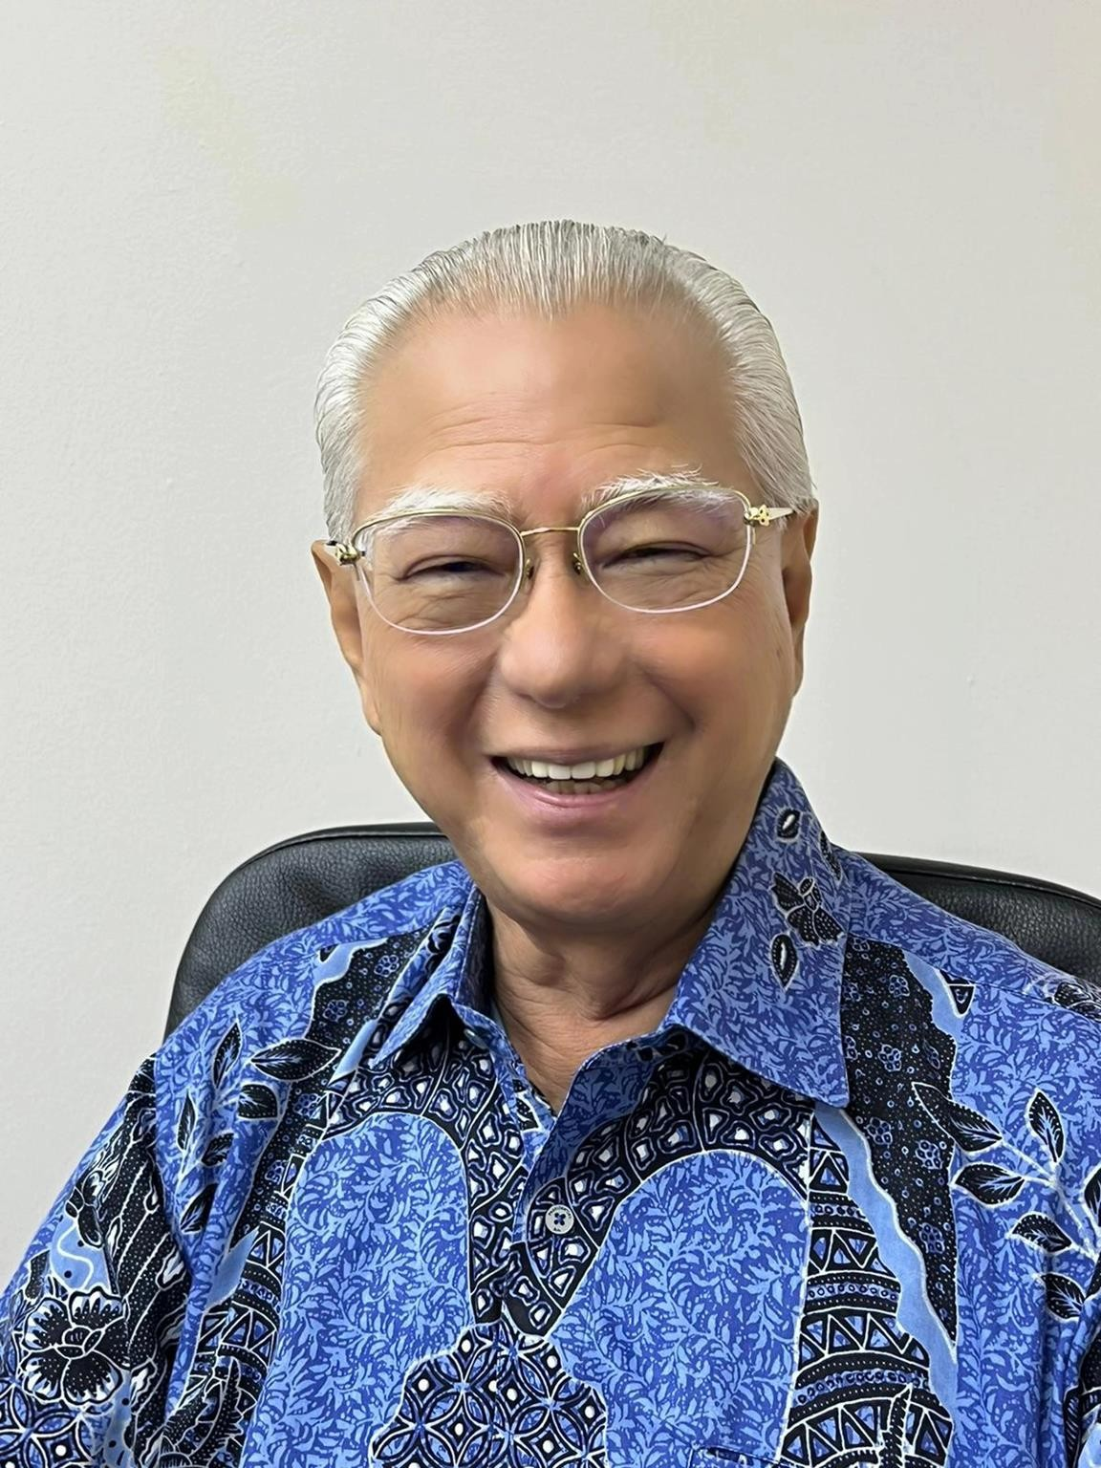

Thank You
For more information, please contact:
Edward Liu, PBM
Managing Director,
Conference & Exhibition Management Services
Honorary President, AFECA Honorary President, SACEOS
Email
edward@cems.com.sg

